Slide 1
Cardiovascular Disease Risk Prediction with Ensemble Modeling
Connor Quinn, Winston Chen,
Lea Li, Yilin Sun

Slide 2
01
02
03
Contents
04
05
06
07
Problem Statement
About Dataset
Data Preprocessing & EDA
Ensemble Modeling
Base Models
Model Evaluation
Live Demo

Slide 3
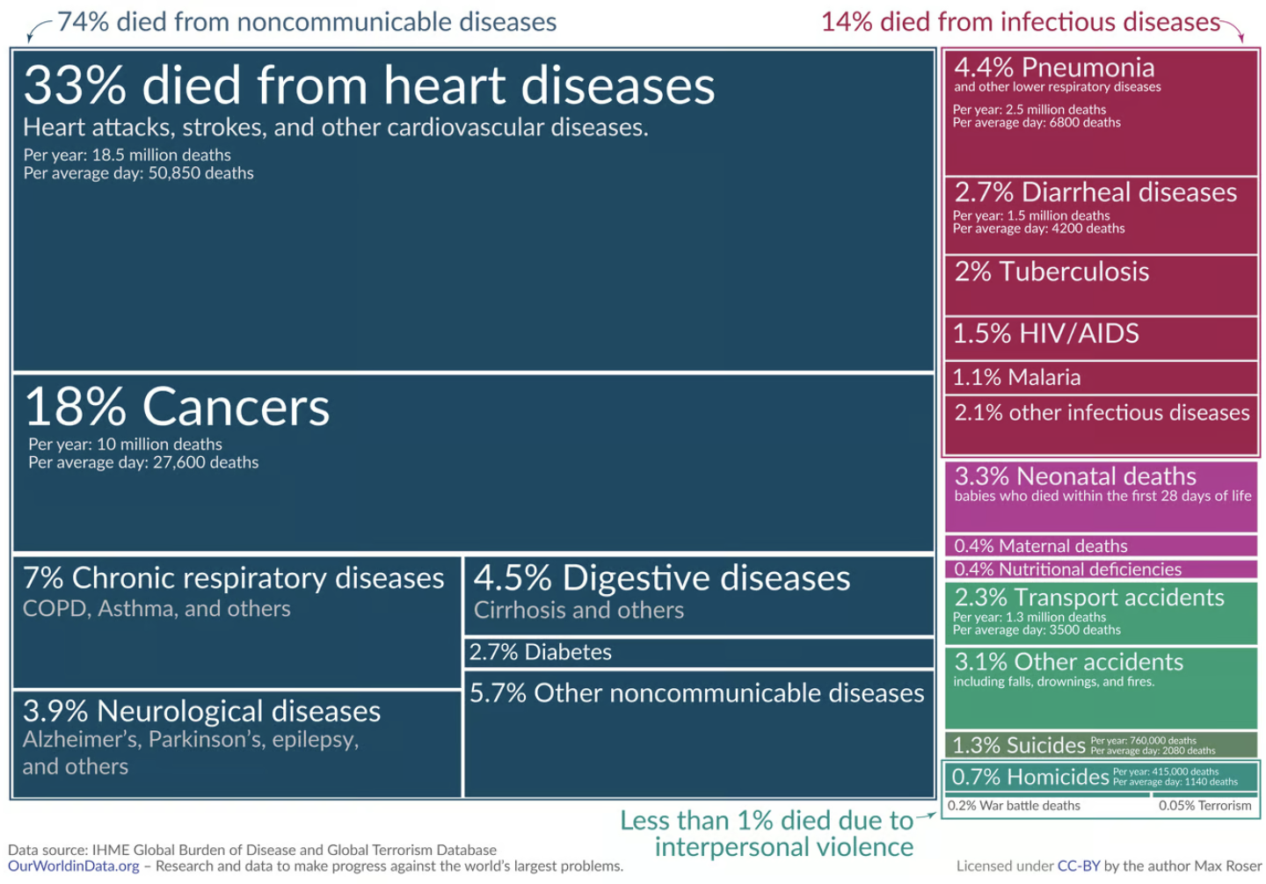
Introduction
Cardiovascular disease (CVD) is the leading cause of death globally,
Approximately 18 million deaths annually.
Nearly one-third of all deaths worldwide.
In the United States alone, nearly half of adults have some form of heart disease or high blood pressure.
Source: https://ourworldindata.org/cardiovascular-diseases?

Slide 4
Problem Statement
CVD conditions are largely preventable through early detection and lifestyle modifications.
Our project makes use of innovative ensembling machine learning to predict heart attack risk based on Behavioral Risk Factor Surveillance System (BRFSS) data. We aim to identify high-risk individuals proactively, enabling timely interventions to reduce the burden of CVD.

Slide 5
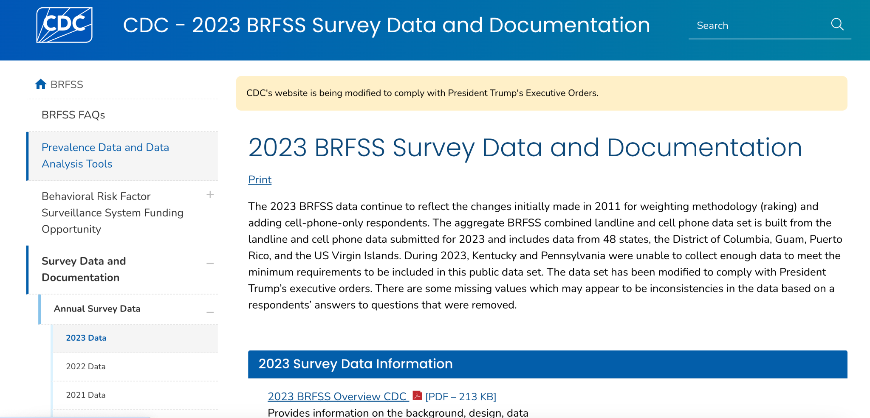
About the Dataset
The CDC 2023 Survey data contains survey questions related to personal information, education, healthecare information, physical conditions, etc.
350 Survey questions
440k surveys conducted

Slide 6
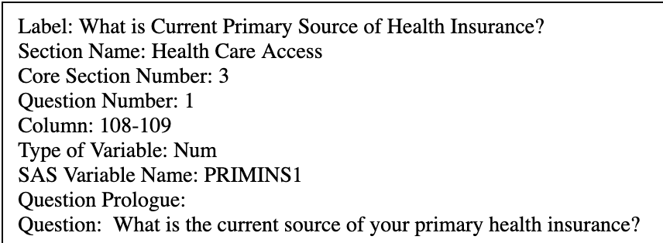
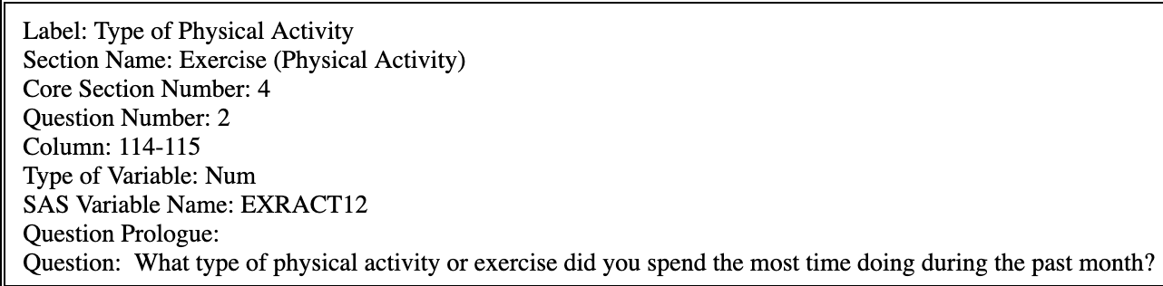
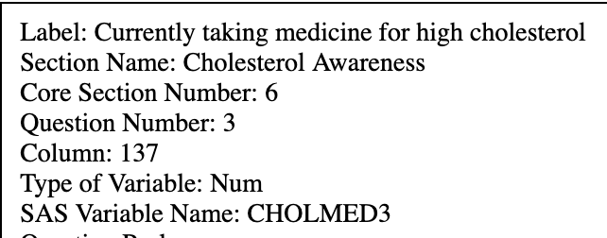
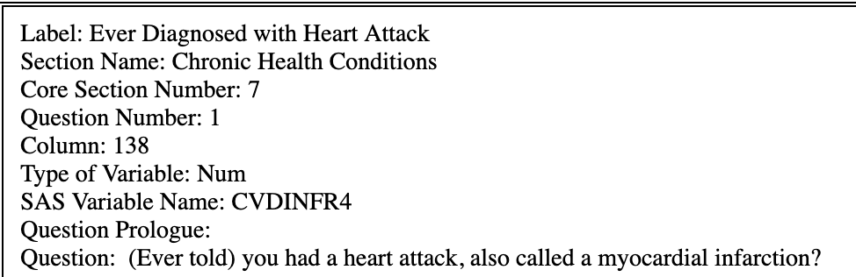
Sample Survey Questions

Slide 7
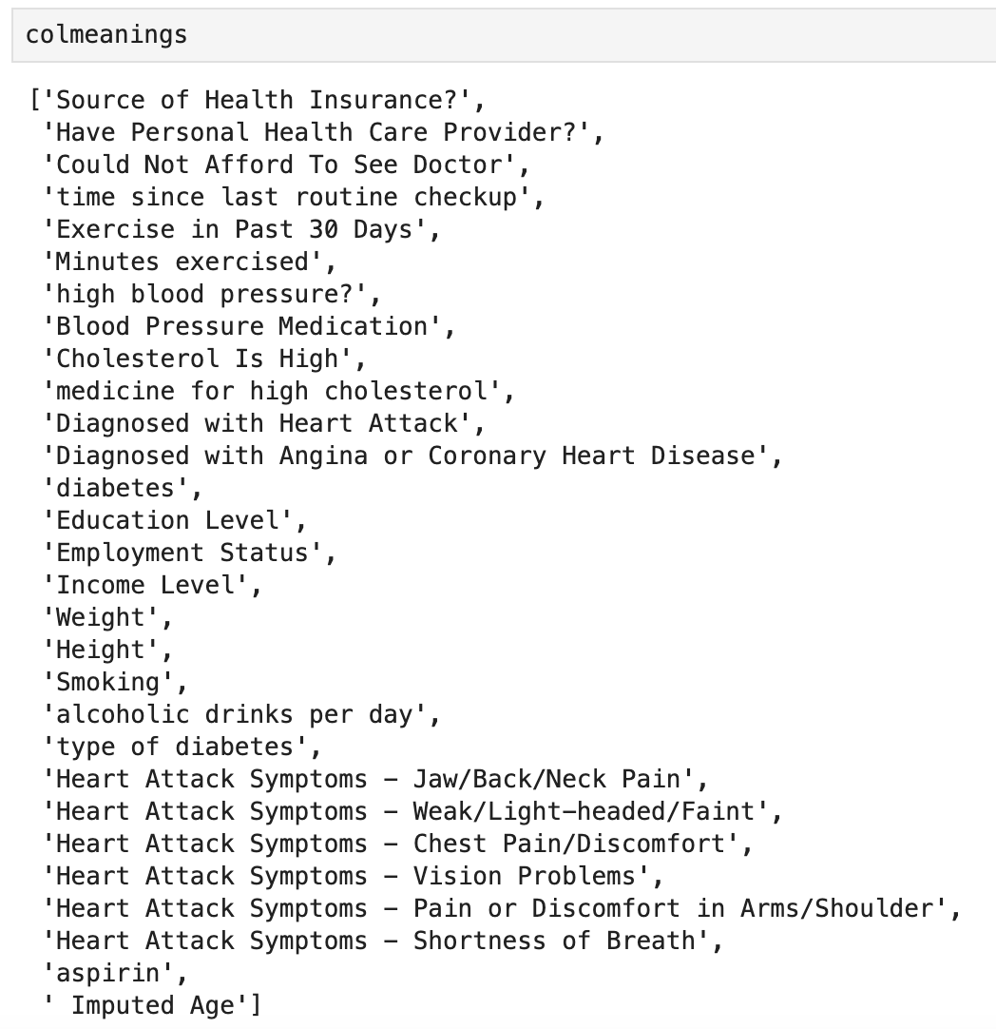
Data Preprocessing
STEP1: Feature Selection
Manually comprehending the metadata
Correlation Ranking
Resulting columns:

Slide 8
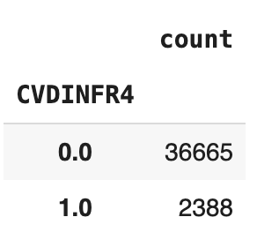
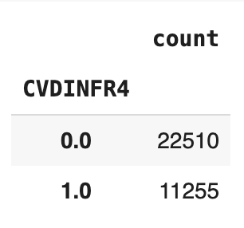
Data Preprocessing
Other Preprocessing:
Linear data imputation for numerical missing values.
Balancing the data by taking a stratified sample of the majority class.
Before
After

Slide 9
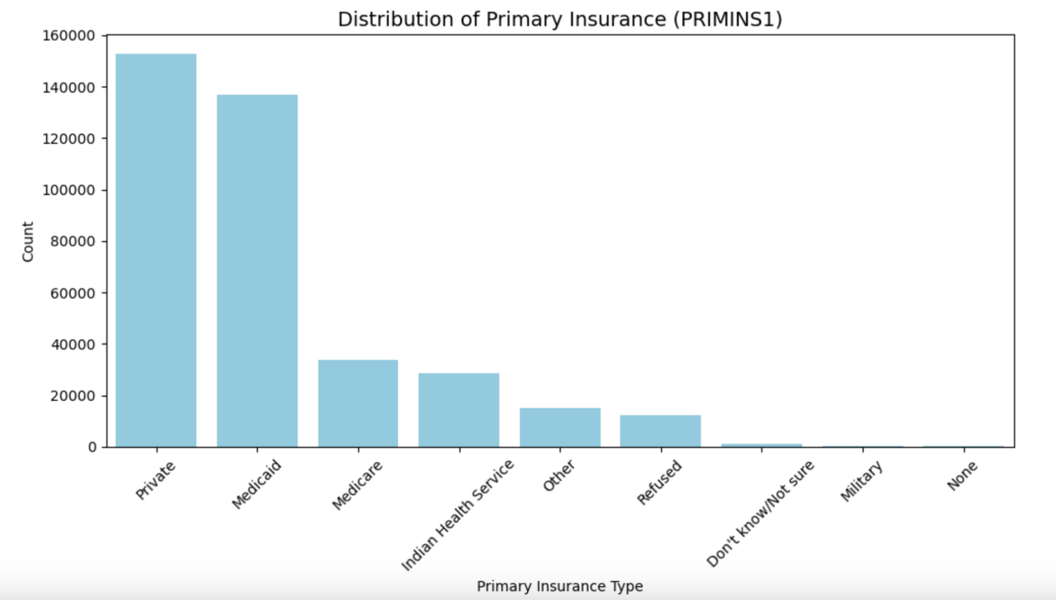
EDA: Univariate

Slide 10
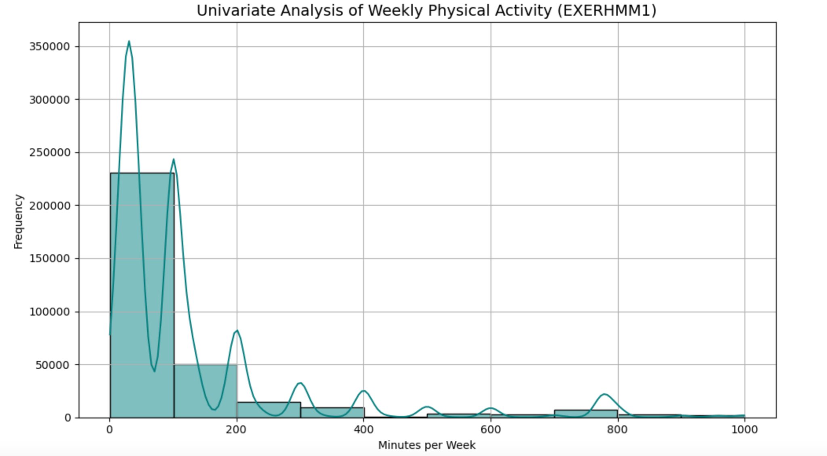
EDA: Univariate

Slide 11
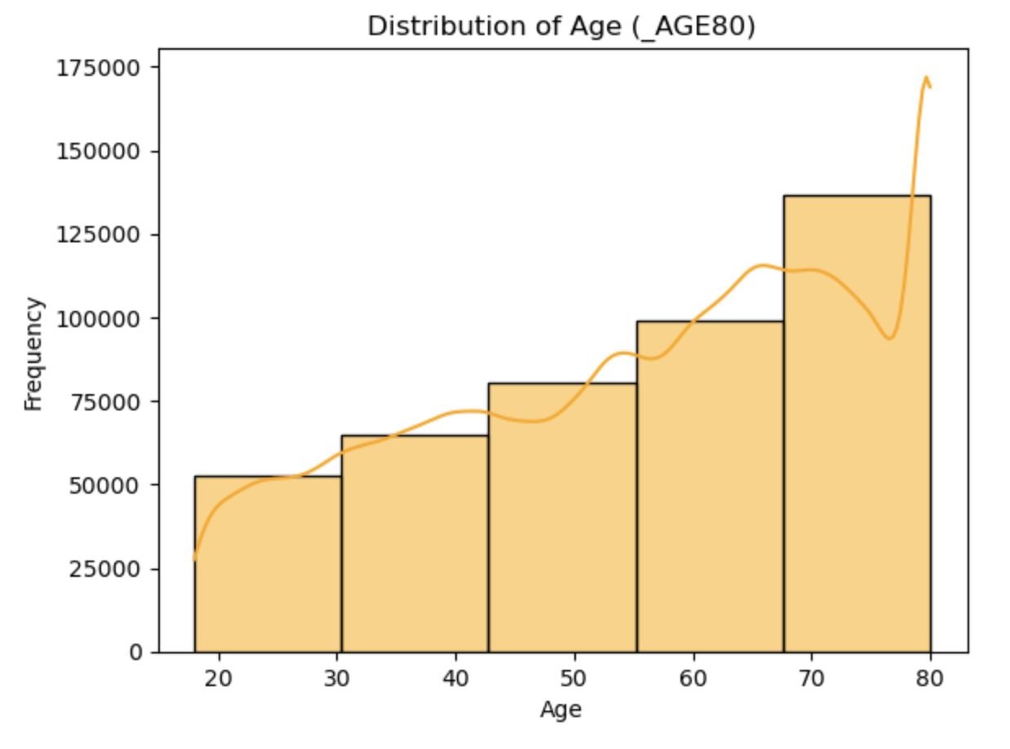
EDA: Univariate

Slide 12
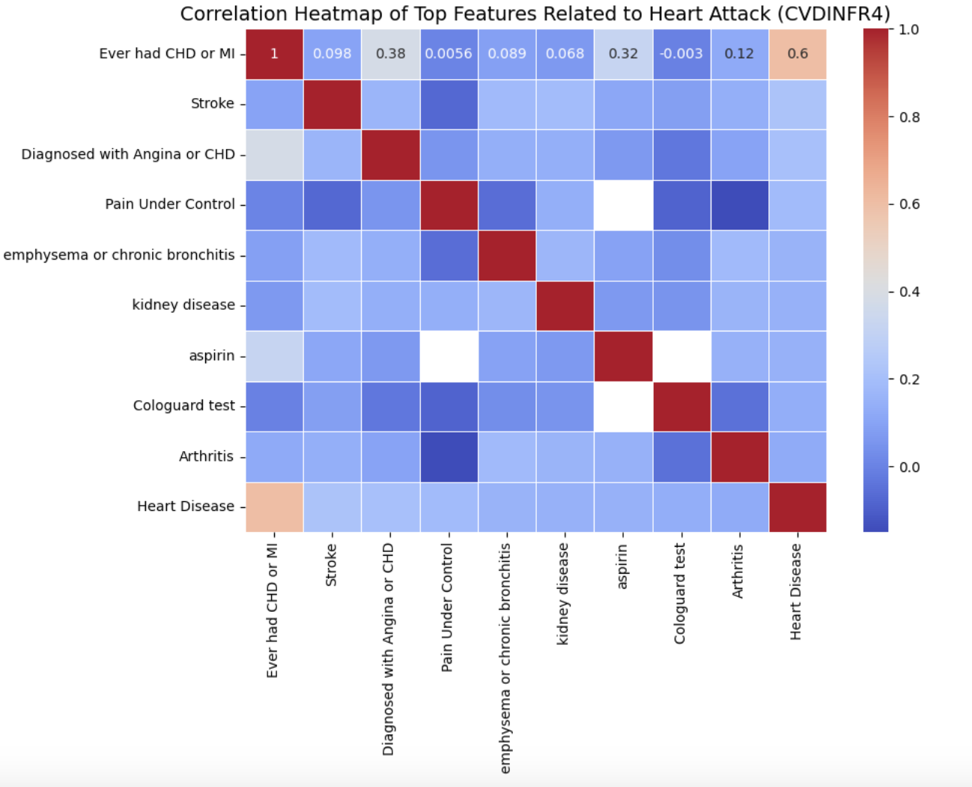
EDA: Correlation

Slide 13
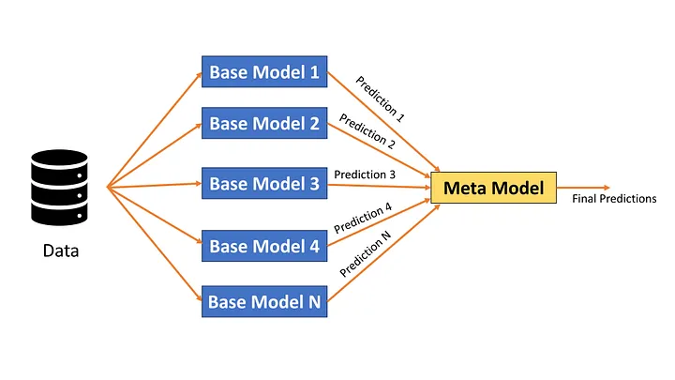
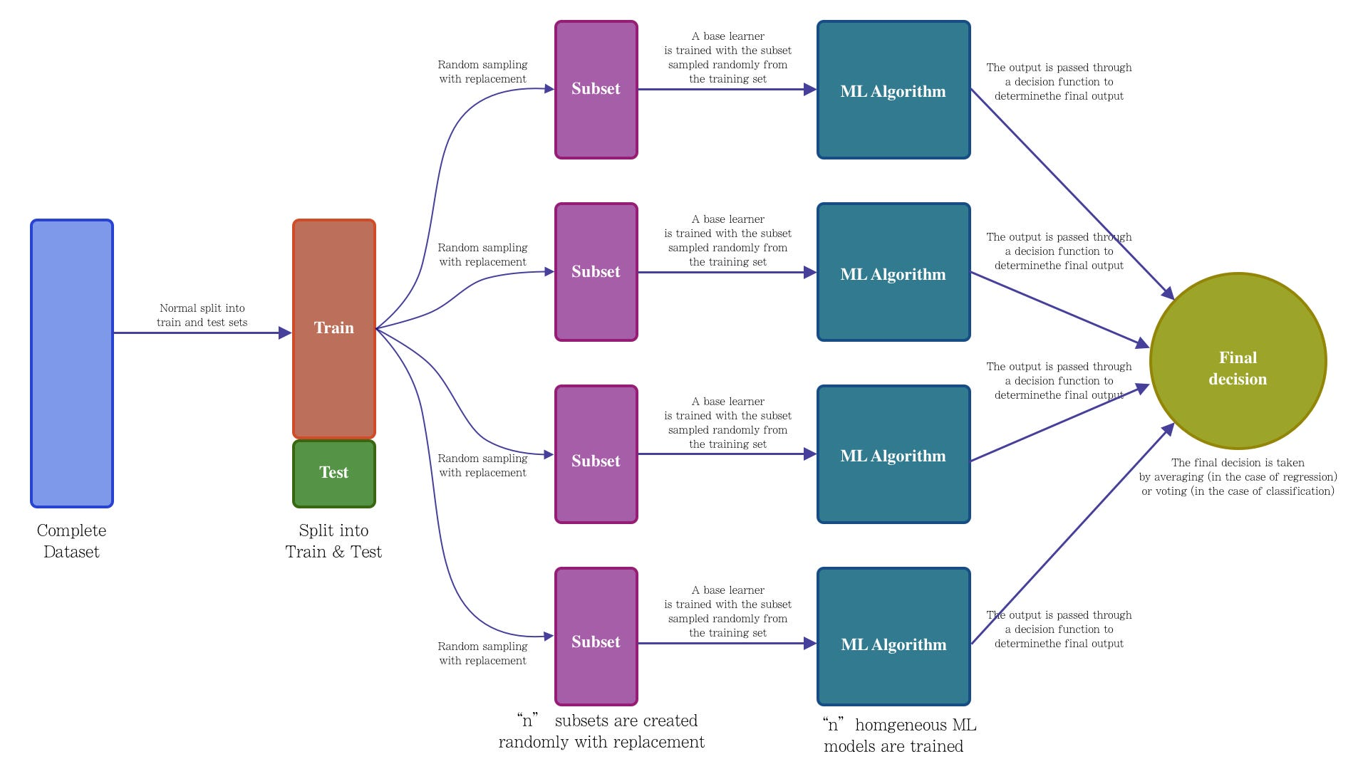
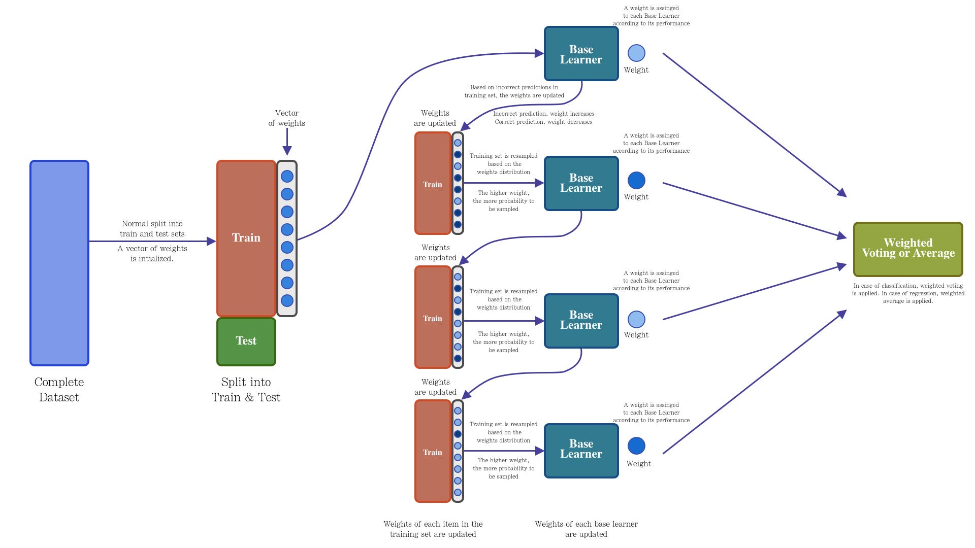
Ensemble Models
Traditional Ensembles:
We decided to investigate 3 main methods of ensembling
Stacking
Bagging
Boosting (Adaboost)
Our literature review demonstrated that these techniques are implemented with one type of base learner, and it’s usually decision trees
https://medium.com/data-and-beyond/stacking-ensemble-technique-in-ml-6d0a98a12607
https://towardsdatascience.com/ensemble-learning-bagging-boosting-3098079e5422/
https://towardsdatascience.com/ensemble-learning-bagging-boosting-3098079e5422/

Slide 14
Ensemble Models
Our Ensembles:
The goal of ensemble methods generally speaking is to reduce variance overall by introducing variance with many base learners, and aggregating their predictions
Since the advantage of ensembling methods comes from the diversity in predictions of the base learners, we thought it would be interesting to try and introduce even more variance by using a diverse collection of base learners.
Our solution builds upon traditional models by allowing them to be run with a diverse collection of base learners, we compare the performance of our diverse ensembles with traditional sklearn ensembles using the same ensemble method.

Slide 15
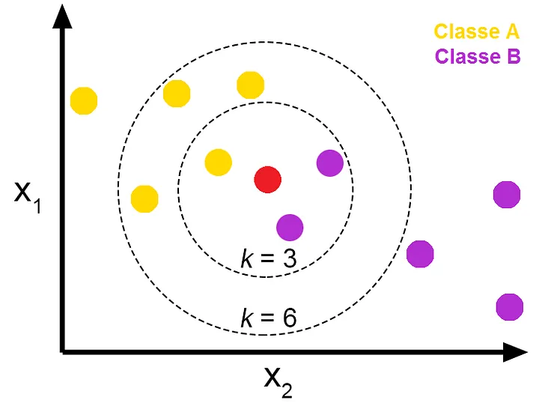
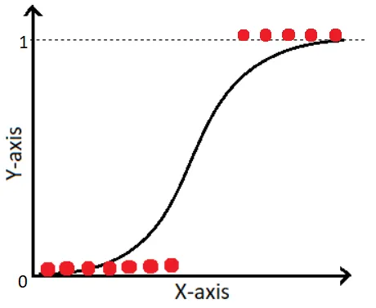
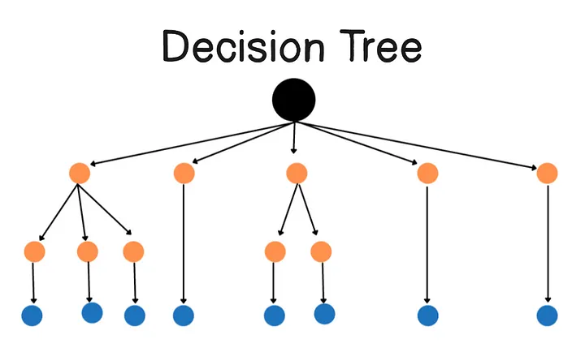
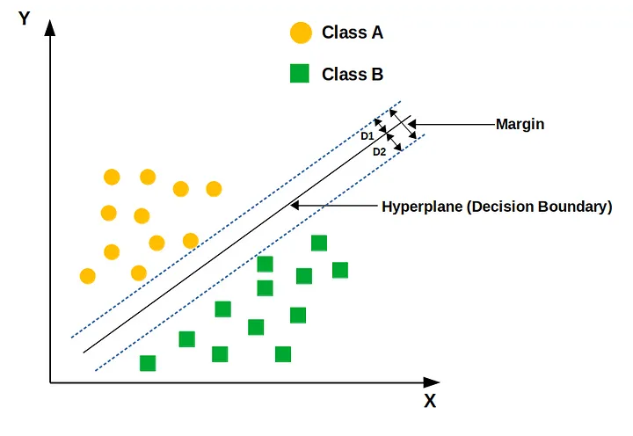
Base Models
Base models:
The problem at hand is one of classification, so we opted to choose base learners that can be used for classification
Of the models that can perform classification that we studied in this class, we selected knn, logistic regression, decision trees, and svm.
https://medium.com/@denizgunay/knn-algorithm-3604c19cd809
https://medium.com/analytics-vidhya/the-math-behind-logistic-regression-c2f04ca27bca
https://medium.com/@fraidoonomarzai99/decision-tree-in-depth-da6ff64d8e54
https://ashish-mehta.medium.com/support-vector-machine-svm-algorithm-for-machine-learning-350fe9139a52

Slide 16
Base Models
Base Model hyperparameters:
To get the best performance out of our ensembles, we wanted to optimize the base learners
We selected what we considered the 3 most important hyperparameters for each base learner and trained base learners using each combination of hyperparameter values, limited to 3 for numerical hyperparameters
KNN
N_neighbors, weights, algorithm
Logistic Regression
Penalty, C, solver
Decision Tree
Criterion, max_depth, min_samples_leaf
SVM
C, kernel, gamma

Slide 17
Base Models
Base Model selection:
We evaluated the base models on the test data, and accumulated the performance metrics and the predictions.
To build the optimal set of ensemble learners we used a disagreement metric that would calculate the degree to which the models had diverse predictions, and we combined that with some performance metrics to select base models that had a diversity in prediction, but consistently good performance.
We used f1 and disagreement at first, then added recall, because given the problem we wanted to prioritize minimizing false negatives.

Slide 18
Model Evaluation (Baseline Models)
Model Type | Number of Base Models | Accuracy | Precision | Recall | F1
Standard Bagging | 5 | 0.76 | 0.79 | 0.70 | 0.75
Standard Bagging | 10 | 0.76 | 0.79 | 0.72 | 0.75
Standard Bagging | 20 | 0.77 | 0.78 | 0.74 | 0.76
Standard Stacking | 5 | 0.76 | 0.78 | 0.72 | 0.75
Standard Stacking | 10 | 0.76 | 0.77 | 0.74 | 0.76
Standard Stacking | 20 | 0.76 | 0.77 | 0.74 | 0.76
Boosting (Standard AdaBoost) | 5 | 0.77 | 0.77 | 0.76 | 0.76
Boosting (Standard AdaBoost) | 10 | 0.76 | 0.78 | 0.73 | 0.75
Boosting (Standard AdaBoost) | 20 | 0.76 | 0.78 | 0.73 | 0.75

Slide 19
Model Evaluation (Diverse Models)
Model Type | Number of Base Models | Accuracy | Precision | Recall | F1-Score
Diverse Bagging | 5 | 0.76 | 0.80 | 0.70 | 0.75
Diverse Bagging | 10 | 0.76 | 0.80 | 0.69 | 0.74
Diverse Bagging | 20 | 0.76 | 0.80 | 0.70 | 0.74
Diverse Stacking | 5 | 0.76 | 0.78 | 0.73 | 0.75
Diverse Stacking | 10 | 0.76 | 0.78 | 0.73 | 0.75
Diverse Stacking | 20 | 0.76 | 0.78 | 0.73 | 0.76
Diverse Boosting | 5 | 0.75 | 0.81 | 0.65 | 0.72
Diverse Boosting | 10 | 0.76 | 0.77 | 0.73 | 0.75
Diverse Boosting | 20 | 0.76 | 0.78 | 0.74 | 0.76

Slide 20
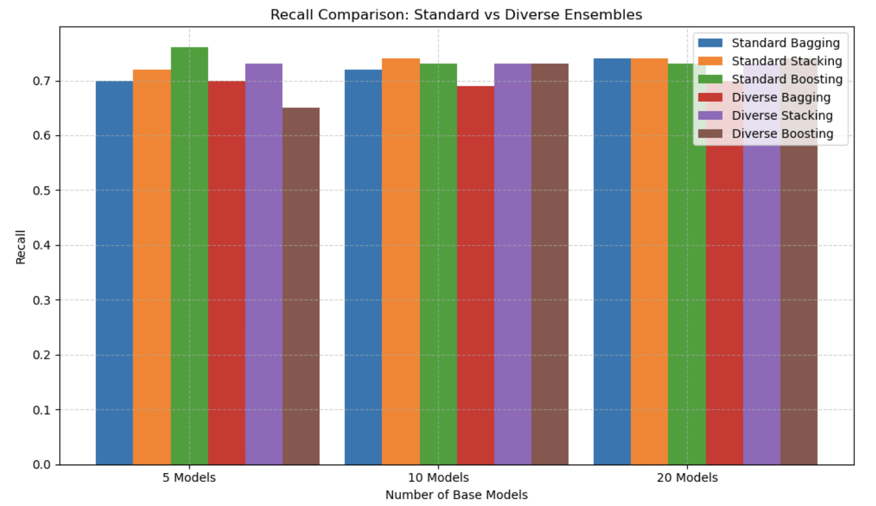
Model Evaluation (Comparison)
Figure 1: Recall Comparison Between Standard and Diverse Ensemble Models.
We observed more stable recall scores as number of base models increase, with diverse boosting slightly outperforming the other models.

Slide 21
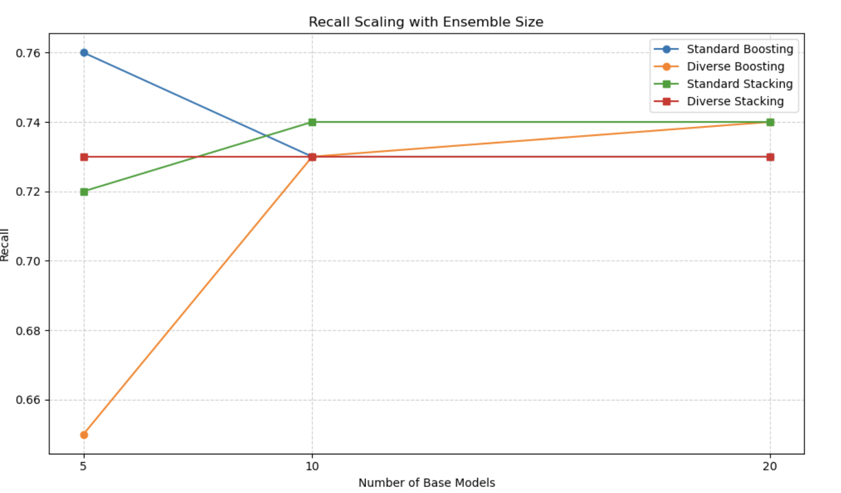
Model Evaluation (Comparison)
Figure 2: Recall scaling with ensemble size.
We see a slight increase in the Recall for standard and diverse stacking models as number of base models increase.
We did not observe any significant outperformance with the diverse model.

Slide 22
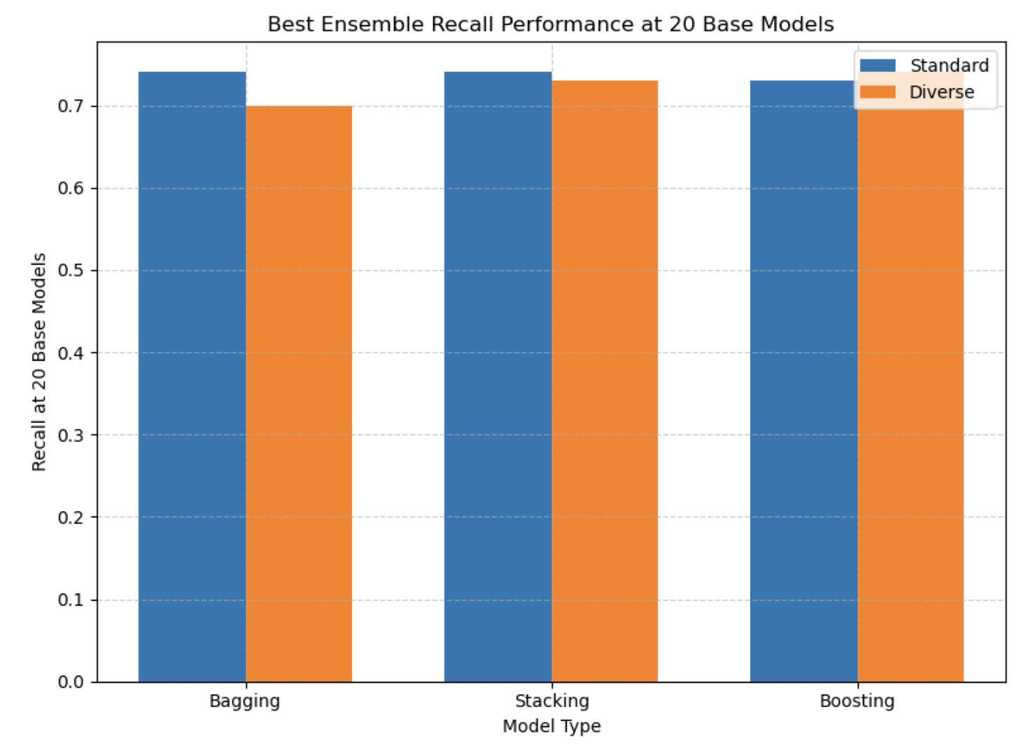
Model Evaluation (Comparison)
Figure 3: Best Ensemble Recall Performance at 20 Base Models.
A side-by-side bar chart comparing the recall scores of bagging, stacking, and boosting methods at 20 base models.
Boosting with diverse base learners slightly outperforms the standard boosting model

Slide 23
Innovation: Data Selection
Traditional cardiovascular risk models often rely on clinical datasets requiring costly and invasive procedures.
This project innovated by utilizing the 2023 Behavioral Risk Factor Surveillance System (BRFSS) survey, a large-scale, publicly accessible health dataset based entirely on self-reported information.
Broader Accessibility: reaching population who may not have regular access to healthcare services.
Early Stage Detection: Self-reported data can capture behavioral risks (e.g., smoking, lack of exercise, obesity) before clinical symptoms manifest.
Rapid, low-risk assessments: the predictive model can be integrated directly into digital surveys, producing immediate risk predictions upon survey completion.

Slide 24
Innovation: Processing
Survey data, by nature, presents unique challenges compared to clean clinical datasets.
Manual Feature Selection with Domain Knowledge: Rather than blindly feeding all survey variables into the model, features were manually curated based on public health research and correlation analysis. This ensured that inputs remained relevant, interpretable, and practically measurable by individuals outside of clinical settings.

Slide 25
Innovation: Modeling
Ensemble Diversity Optimization: Base models were selected for disagreement, using recall and output diversity, rather than blindly stacking similar models. This technique improves ensemble generalization without expanding model size.
Custom Boosting and Stacking: Both standard scikit-learn and custom ensemble frameworks were implemented, with flexible hyperparameter tuning, custom cross-entropy boosting, and meta-learner design based on logistic regression.

Slide 26
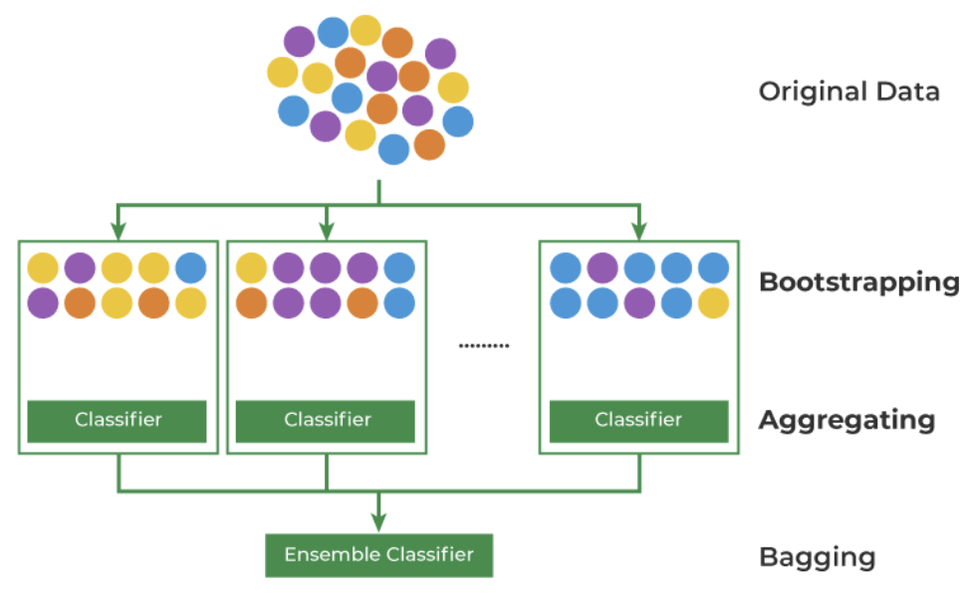
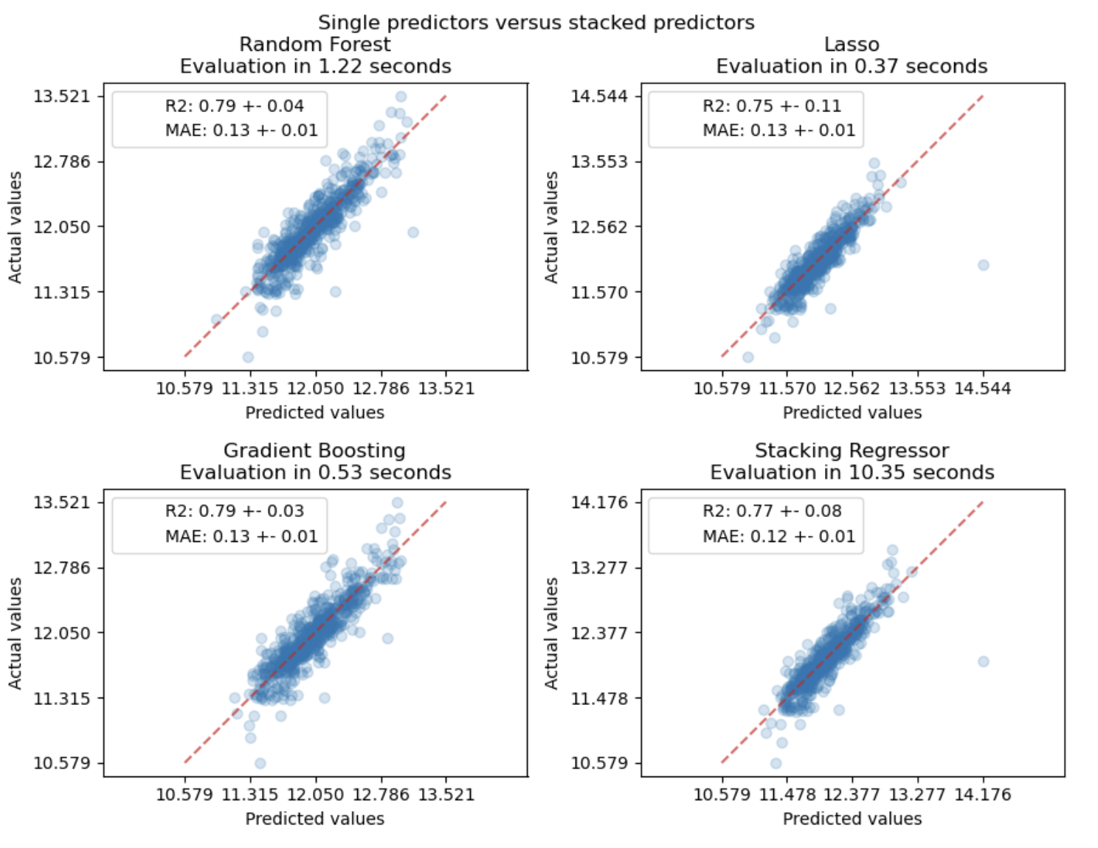
https://www.geeksforgeeks.org/ml-bagging-classifier/
https://scikit-learn.org/stable/auto_examples/ensemble/plot_stack_predictors.html

Slide 27
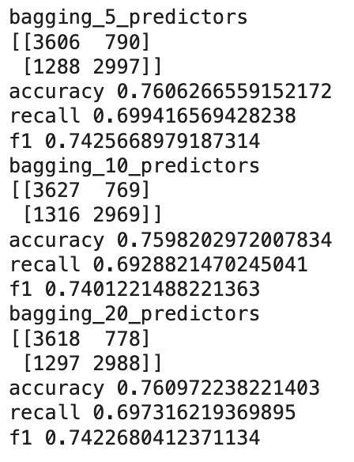
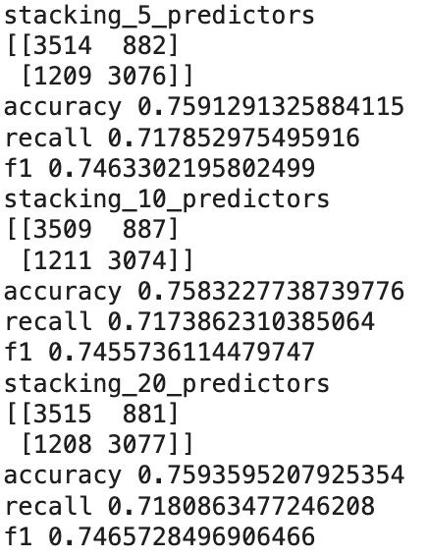
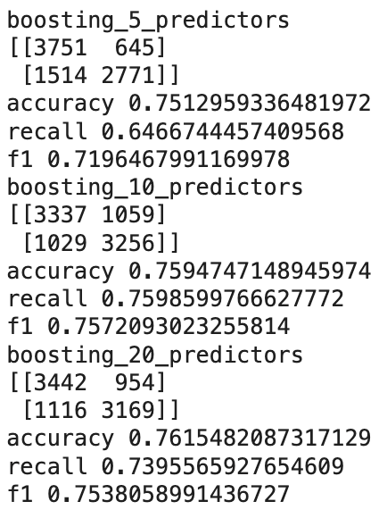
Predicting
Bagging n predictor
Stacking n predictor
Boosting n predictor
#diverse_boosting
#standard_boosting
#diverse_bagging
#standard_bagging
#diverse_stacking
#standard_stacking

Slide 28
diverse_bagging_avg_performace = {5: {'accuracy': 0.7655868369769883, 'precision': 0.800438357758521, 'recall': 0.7076073799835798, 'f1': 0.7511525469754379}, 10: {'accuracy': 0.7659785287749027, 'precision': 0.8029276271395529, 'recall': 0.7050277892591449, 'f1': 0.7507933964890523}, 20: {'accuracy': 0.7667849591538701, 'precision': 0.8017197195663162, 'recall': 0.708932584804851, 'f1': 0.7524736157282391}}
diverse_stacking_avg_performace = {5: {'accuracy': 0.766277990972392, 'precision': 0.7856425111336739, 'recall': 0.7324012763006985, 'f1': 0.7580807265149134}, 10: {'accuracy': 0.7673609535523578, 'precision': 0.787316423970063, 'recall': 0.7326688588443074, 'f1': 0.7590049056547079}, 20: {'accuracy': 0.766139877490807, 'precision': 0.7849111279445024, 'recall': 0.7332271992148243, 'f1': 0.7581830603735948}}
diverse_boosting_avg_performace = {5: {'accuracy': 0.7524997757165524, 'precision': 0.8173411041983474, 'recall': 0.6503803924891853, 'f1': 0.7243343491437837}, 10: {'accuracy': 0.7624072010646695, 'precision': 0.7681612845597906, 'recall': 0.7530885125290866, 'f1': 0.7601138111932858}, 20: {'accuracy': 0.7665083897934841, 'precision': 0.7865049064311023, 'recall': 0.7316015343377453, 'f1': 0.758037050413783}}
standard_bagging_avg_performace = {5: {'accuracy': 0.7654486412139017, 'precision': 0.780685012173905, 'recall': 0.7385004035052031, 'f1': 0.758934129430891}, 10: {'accuracy': 0.7691120950091227, 'precision': 0.7861300646030722, 'recall': 0.7394298775195786, 'f1': 0.7619939238381535}, 20: {'accuracy': 0.7715773974308, 'precision': 0.7855973425189727, 'recall': 0.7471471762291529, 'f1': 0.765875640010823}}
standard_stacking_avg_performace = {5: {'accuracy': 0.7683518139355137, 'precision': 0.7784407077735066, 'recall': 0.7506776032441402, 'f1': 0.7641833565478902}, 10: {'accuracy': 0.7689509373986411, 'precision': 0.7811352449512374, 'recall': 0.7475148067791644, 'f1': 0.7638417215954647}, 20: {'accuracy': 0.7689508869680435, 'precision': 0.779227947525419, 'recall': 0.7507101196481999, 'f1': 0.7646289193739172}}
standard_boosting_avg_performace = {5: {'accuracy': 0.7705865821697578, 'precision': 0.7725632963117623, 'recall': 0.7669262306762488, 'f1': 0.7697282512112316}, 10: {'accuracy': 0.769987503828744, 'precision': 0.7723559436382901, 'recall': 0.765630097690992, 'f1': 0.7689571009471807}, 20: {'accuracy': 0.7620386144432171, 'precision': 0.7551660317585285, 'recall': 0.7781511497583844, 'f1': 0.7658881071254138}}

Slide 29
Thank You
DATA 245

